Slide 1
GO Team Meeting #2
Where we are – Where we’re going

Slide 2
Where We Are
Our strategic plan is the guide for the work we’re doing in the school. By monitoring the plan and ranking priorities, we can all work towards the common goals. Using the priorities in the strategic plan, the school leadership team developed a Continuous Improvement Plan (CIP) for the current school year.

Slide 3
Timeline for GO Teams
Fall 2021
GO Team Developed 2021-2025 Strategic Plan
1
Summer 2022
School Leadership completed Needs Assessment and defined overarching needs for SY22-23
2
August 2022
School Leadership completed 2022-2023 Continuous Improvement Plan
3
Sept. – Dec. 2022
Utilizing current data, the GO Team will review & possibly update the school strategic priorities and plan
4
Before Winter Break
GO Team will take action (vote) on the rank of the strategic plan priorities for SY23-24 in preparation for budget discussions.
5

Slide 4
Discussion Items
Current Strategic Plan
Continuous Improvement Plan
Needs Assessment
SMART GOALS
Monitoring Measures
MAP Data
Data Protocol

Slide 5
Current Strategic Plan
2021-2025

Slide 6
Mission: With a caring culture of equity, trust and collaboration, every Mary Lin Rocket will be promoted to middle school with independence, curiosity, and the desire to achieve.
Mary Lin Elementary School
Vision: We encourage academic achievement in each student. We establish a creative, collaborative, and respectful culture where each student’s social, emotional, and physical well-being is valued.
SMART Goals
Percentage of students in grades 3-5 scoring proficient in ELA will increase by 1% each year through 2025. Currently MLE has 89% proficient ELA.
Percentage of students in grades 3-5 scoring proficient in Math will increase by 2% each year through 2025. Currently MLE has 76% proficient Math.
Show overall growth for at least 75% of the population in both ELA and Math. At least 75% of our kids show 30
Close the achievement gap between all subgroups.
APS Strategic Priorities & Initiatives
School Strategic Priorities
School Strategies
Fostering Academic Excellence for All
Data
Curriculum & Instruction
Signature Program
1. Use data to inform instruction
2. Adhere to the scope and sequence of the Georgia Standard of Excellence and supplement with other resources.
Hold monthly data digs lead by administration.
Weekly lesson planning and internalization lead by instructional coaches.
1. Create collaborative school culture that embraces diverse families that comprise the Mary Lin Community.
2. Build teacher capability to meet the diverse social, emotional, and academic needs of students.
3. Provide unique learning opportunities to cultivate students’ curiosity of learning.
4. Prioritize students’ social and emotional growth as a means to ensuring future success.
Created a new Equity, Diversity, and Inclusion Committee on our PTA.
Provide equity and anti-basis training for all staff members.
Engages students in weekly STEM Activities, Science Fair, Science Night, Spelling Bee, Math Family Night, Inclusive School’s Week, No Place for Hate Week, Red Ribbon Week, Black History Celebration, and Girls on the Run, LEEP after-school activities, and Helen Ruffin Reading Bowl.
Administer BASC to screen for students who need additional support. Implement small group and individual counseling sessions. Dedicate 15 protected minutes for Morning Meeting and Second Step lessons that focus on social and emotional growth.
Building a Culture of Student Support
Whole Child & Intervention
Personalized Learning
Equipping & Empowering Leaders & Staff
Strategic Staff Support
Equitable Resource Allocation
Our Mary Lin Foundation Grants must be screened and approved.
Additional Support Staff hired (Nurse, hourly intervention teachers, full-time substitutes,, etc.).
Provide professional learning opportunities to empowering and equipping teachers to work with our diverse population.
1. Equitably align our school resources with our mission and vision
Creating a System of School Support
Collective Action, Engagement & Empowerment
1. Provide an environment that retains, empowers, motivates, and inspires teachers to utilize individual strengths
System of accountability for school-based leaders.
Leadership and professional learning opportunities for all staff members based on strengths.

Slide 7
Continuous Improvement Plan
SY 2022-2023

Slide 8
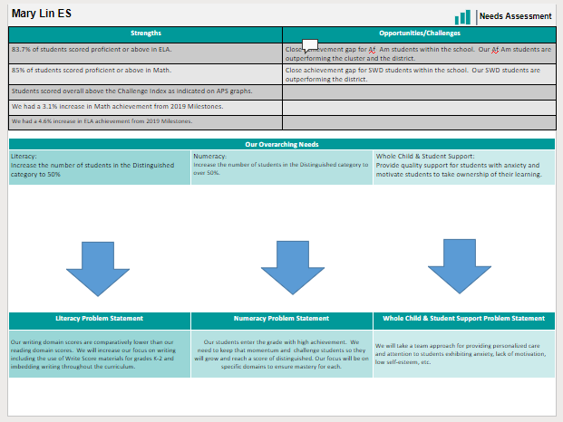
Needs Assessment
Notes:
Notes for School CIP Teams: After completing your Comprehensive Needs Assessment ( data protocol), you will come here and identify some strengths and opportunities/challenges you have observed from the data. The priority areas are Literacy, Numeracy, and Whole Child & Student Support. Identify an overarching need for each area. Formulate a problem statement for each area. Make sure the problem statement meets the criteria. Refer to your CIP resources.

Slide 9
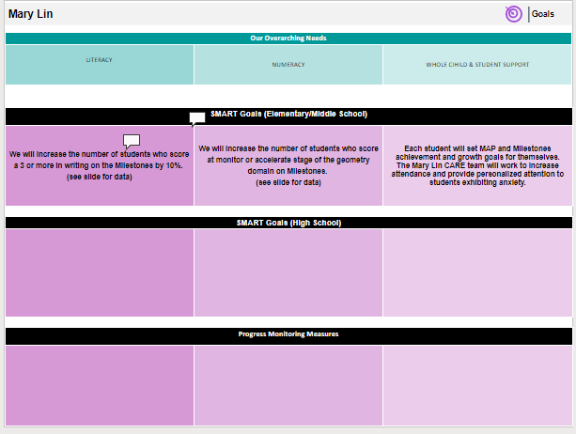

Slide 10
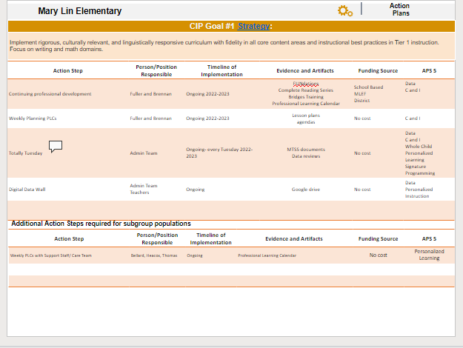
Progress Monitoring Measures

Slide 11
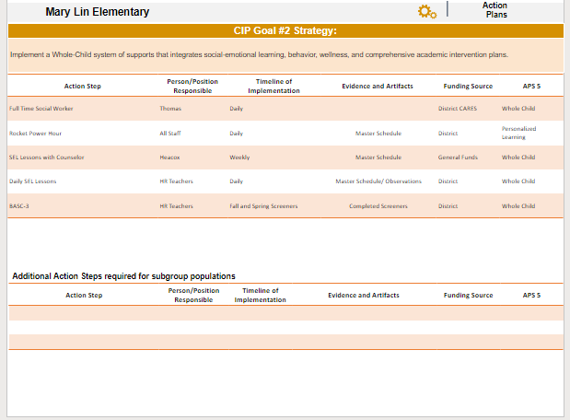

Slide 12
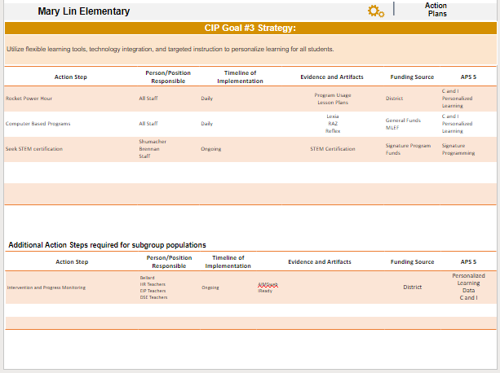

Slide 13
MAP Data
1st Administration

Slide 14
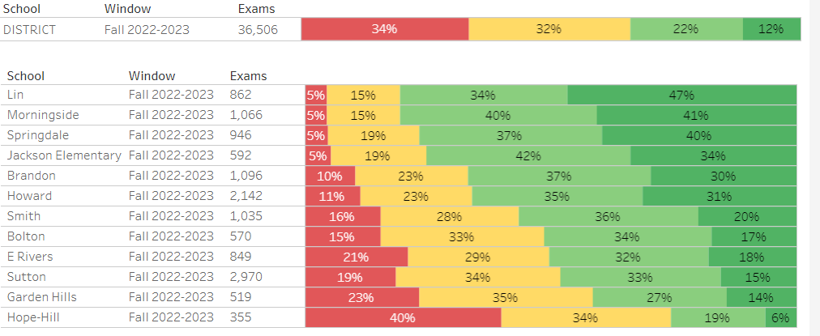

Slide 15
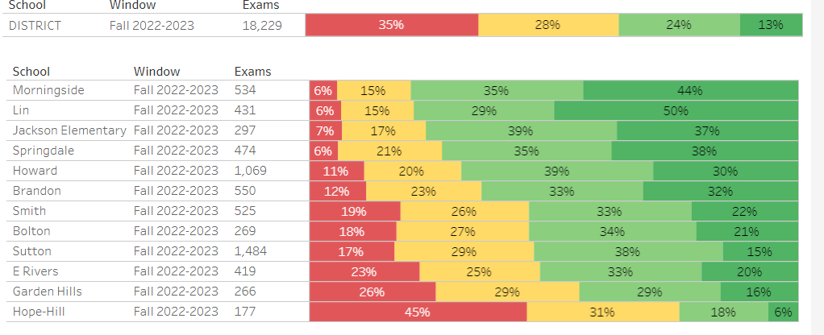

Slide 16
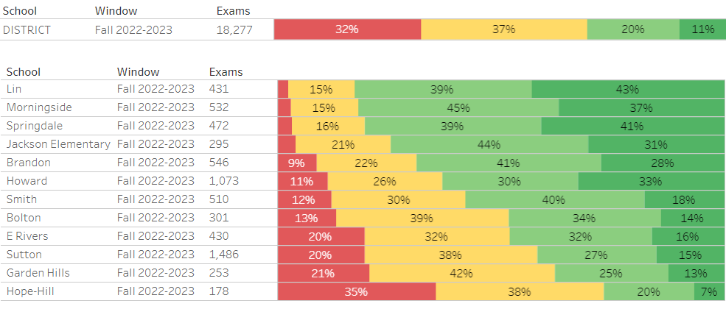

Slide 17
GO Team Discussion: Data Protocol
What do you notice?
What are your wonderings?
What addition questions do you have?

Slide 18
Strategic planning will help you fully uncover your available options, set priorities for them, and define the methods to achieve them.
Robert J. Mckain

Slide 19
Where we’re going
At our next meeting(s) we will discuss how our data is aligning to our strategic plan and determine if we need to make any adjustments.
Before we leave for Winter Break, we will take Action (vote) on ranking our strategic priorities for the 2023-2024 school year.
Let me or the Chair know of any additional information you need for our future discussion.

Slide 20
Thank you

